Slide 1


Insect Detection & Categorization in Rice Fields Using Image Processing & YOLO
Supervisor: Van Lic TRAN | 2024 - 2025 ​
Winqwist Arthur
Notes:
Good morning everyone. Today I'll present my research on developing an intelligent pest detection system for rice cultivation, called InsectDetect Pro. This work represents the development of a harmful insect classification and alert system for rice fields using advanced image processing and AI techniques. This research was conducted during my internship at Danang University of Science and Technology in collaboration with Polytech Marseille. The project addresses a critical challenge in global agriculture - the need for early, accurate pest detection to protect rice crops.

Slide 2
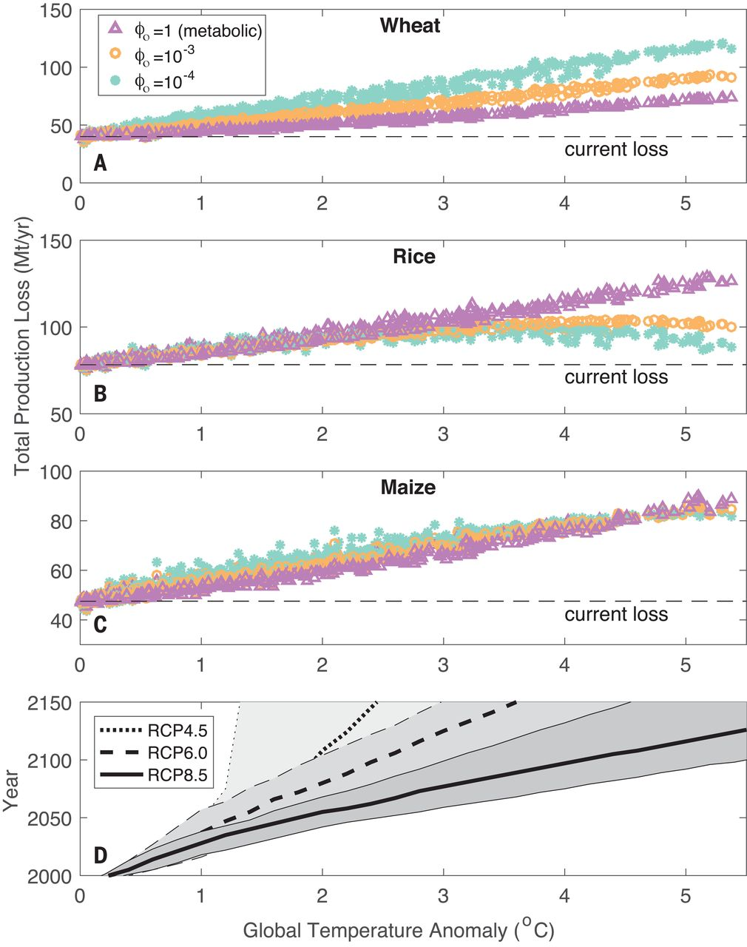
The Problem - Rice Cultivation Challenges
Rice feeds over half the global population
Pest infestations cause 20-40% yield losses
Manual inspection is labor-intensive and often too late
Need for automated detection systems
Notes:
Rice is fundamental to global food security, serving as a staple food for over half the world's population. With the global population projected to reach 9.7 billion by 2050, maintaining and improving rice production efficiency is critically important. However, rice cultivation faces significant threats from pest infestations. Current data shows that pest damage can cause yield losses of 20 to 40 percent in severe cases - this represents billions of dollars in economic losses annually. The traditional approach relies on manual inspection by farmers or agricultural experts. This method has several critical flaws: it's extremely labor-intensive, time-consuming, and inconsistent due to human factors like experience level and subjective judgment. Most importantly, manual inspection often results in delayed detection, meaning by the time pests are identified, significant crop damage has already occurred. We needed a solution that could provide early, automated, and accurate pest detection.

Slide 3
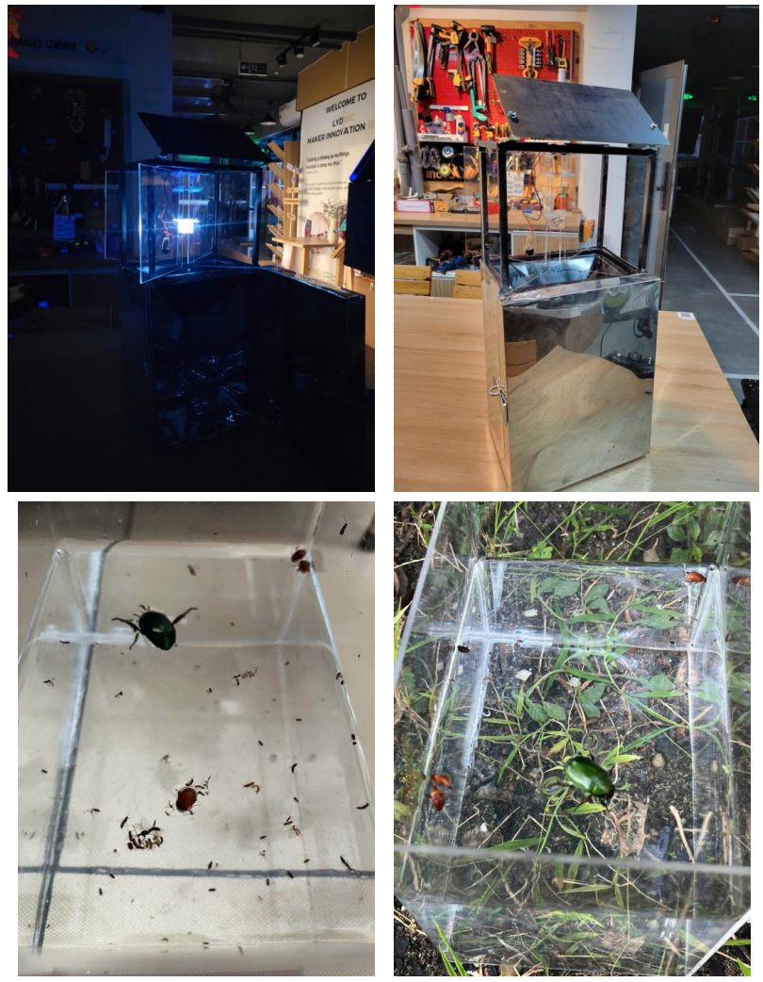
Research Objectives
Develop cost-effective automated pest detection system
Enable early warning for farmers
Integrate IoT + AI for real-time monitoring
Create scalable solutions for developing regions
Notes:
Our research aimed to address these challenges through four key objectives: First, develop a cost-effective automated pest detection system that farmers in developing regions could actually afford and deploy. Second, enable early warning capabilities that would allow farmers to intervene before significant crop damage occurs. Third, integrate Internet of Things technology with artificial intelligence to create a real-time monitoring solution. Finally, create a scalable system that could be easily expanded across multiple fields and adapted for different agricultural contexts. The goal was not just to create a technical proof-of-concept, but a practical system that could make a real difference for rice farmers.

Slide 4
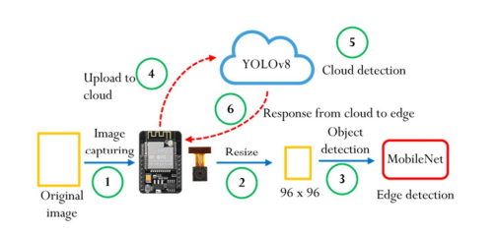
System Architecture Overview
ESP32-CAM modules for field image capture
Flask server with YOLOv11s processing
Web-based monitoring dashboard
Hybrid edge-cloud architecture
Notes:
Our solution employs a hybrid edge-cloud architecture designed to balance computational efficiency, reliability, and practical deployment considerations. The system consists of three primary components: First, field-deployed ESP32-CAM modules that serve as our sensing units. These capture high-resolution images of the rice field environment at regular intervals. Second, a centralized Flask server that runs our YOLOv11s deep learning model for pest detection and classification. This server processes all incoming images and performs the complex AI analysis. Third, a web-based dashboard that provides farmers with real-time monitoring capabilities and analytics. Initially, we considered deploying the AI model directly on the ESP32 devices for on-device inference. However, preliminary testing revealed significant limitations in computational capacity and memory constraints when running complex architectures like YOLO variants. The hybrid approach gives us the benefits of distributed edge sensing while leveraging centralized processing power for higher accuracy results. The ESP32-CAM modules capture field images and transmit them wirelessly to the server, where our trained model analyzes them and returns actionable insights to farmers through the web interface.

Slide 5
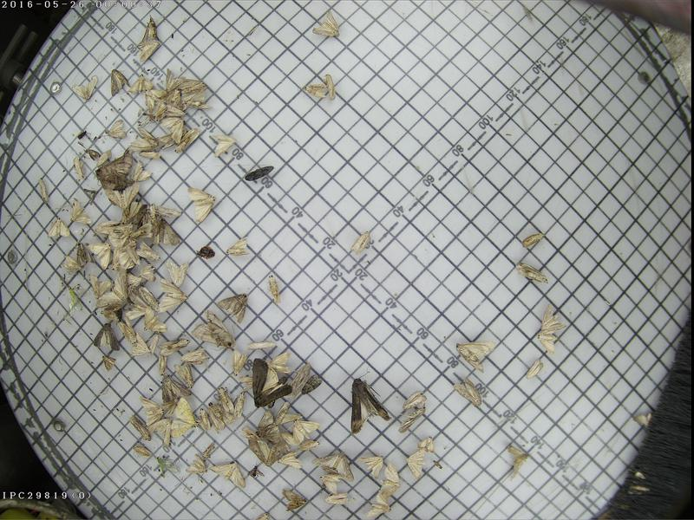
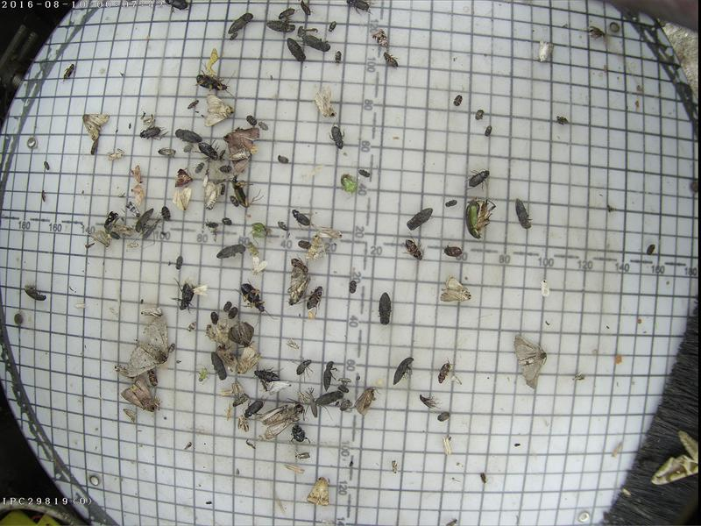
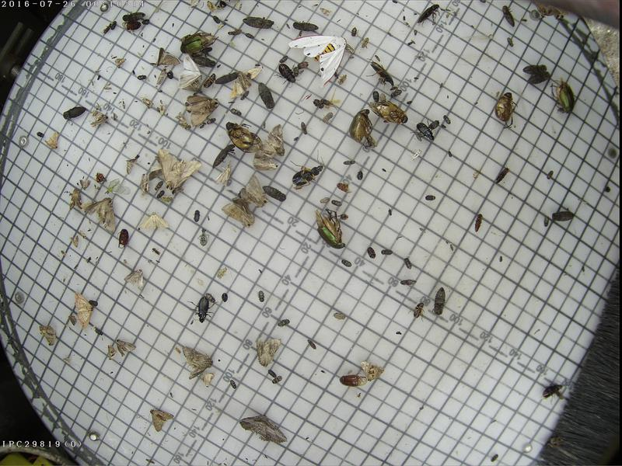
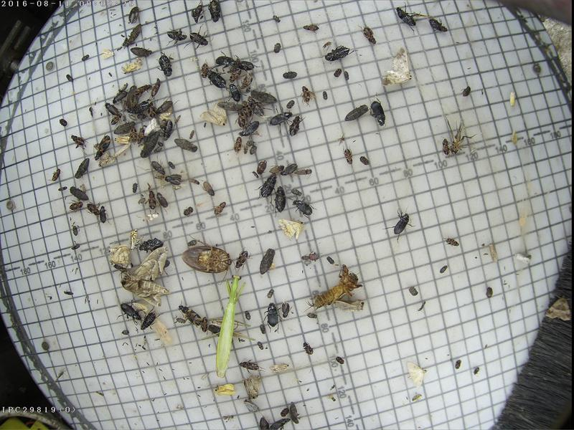
AI Model - YOLOv11s
Trained on PEST24 dataset (25,000 images, 24 classes)
Three-tier classification: Harmful, Caution, Safe
Balanced accuracy-speed tradeoff
Notes:
For pest detection and classification, we selected YOLOv11s - the latest version of the You Only Look Once architecture. YOLO models are particularly well-suited for this application because they provide an optimal balance between detection accuracy and processing speed. Our model was trained using the PEST24 dataset, which contains 25,000 pre-labeled images across 24 classes of agricultural insects. This dataset was developed in China and shares a relatively common insect population with Vietnam, making it highly relevant for our deployment context. We used transfer learning, initializing our model with weights pre-trained on the COCO dataset, then finetuning on the PEST24 agricultural data. Training was conducted over 100 epochs with early stopping, using AdamW optimization and cosine learning rate scheduling. A crucial innovation in our system is the three-tier classification approach. Rather than simply detecting insects, our system categorizes them based on their threat level to rice crops. We have harmful insects like rice planthoppers and leaf rollers that require immediate intervention, caution-level insects like various tiger species that warrant monitoring, and safe insects like geckos that are actually beneficial to the agricultural ecosystem. This classification system transforms raw detection data into actionable intelligence for farmers.

Slide 6
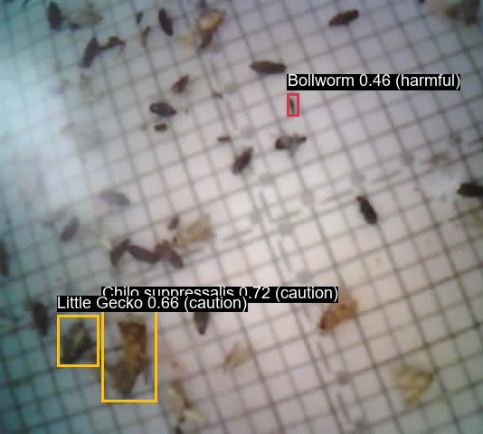
Insect Classification System
Harmful (18 species): planthopper, leaf roller, armyworm
Caution (5 species): yellow tiger, land tiger
Safe (1 species): little gecko
Color-coded categories for easy interpretation
Notes:
Our classification system organizes detected insects into three risk-based categories, each color-coded for immediate visual recognition. The harmful category includes 18 species of insects that pose direct threats to rice crops. These include rice planthoppers, rice leaf rollers, stem borers, and armyworms. When these insects are detected, the system generates red alerts indicating immediate intervention may be necessary. The caution category contains 5 species like yellow tigers and land tigers. These insects may cause crop damage under certain conditions but don't require immediate action. They generate yellow alerts for monitoring. The safe category currently includes beneficial species like little geckos, which actually help control harmful insects. These generate green indicators. This categorization is crucial for practical implementation. Instead of overwhelming farmers with generic "insect detected" alerts, our system provides specific guidance on the level of concern and appropriate response. This helps farmers prioritize their time and resources, focusing intervention efforts where they're most needed while avoiding unnecessary pesticide applications for harmless or beneficial species. The color-coded system makes the information immediately actionable, even for farmers who may not be familiar with specific insect species names.

Slide 7
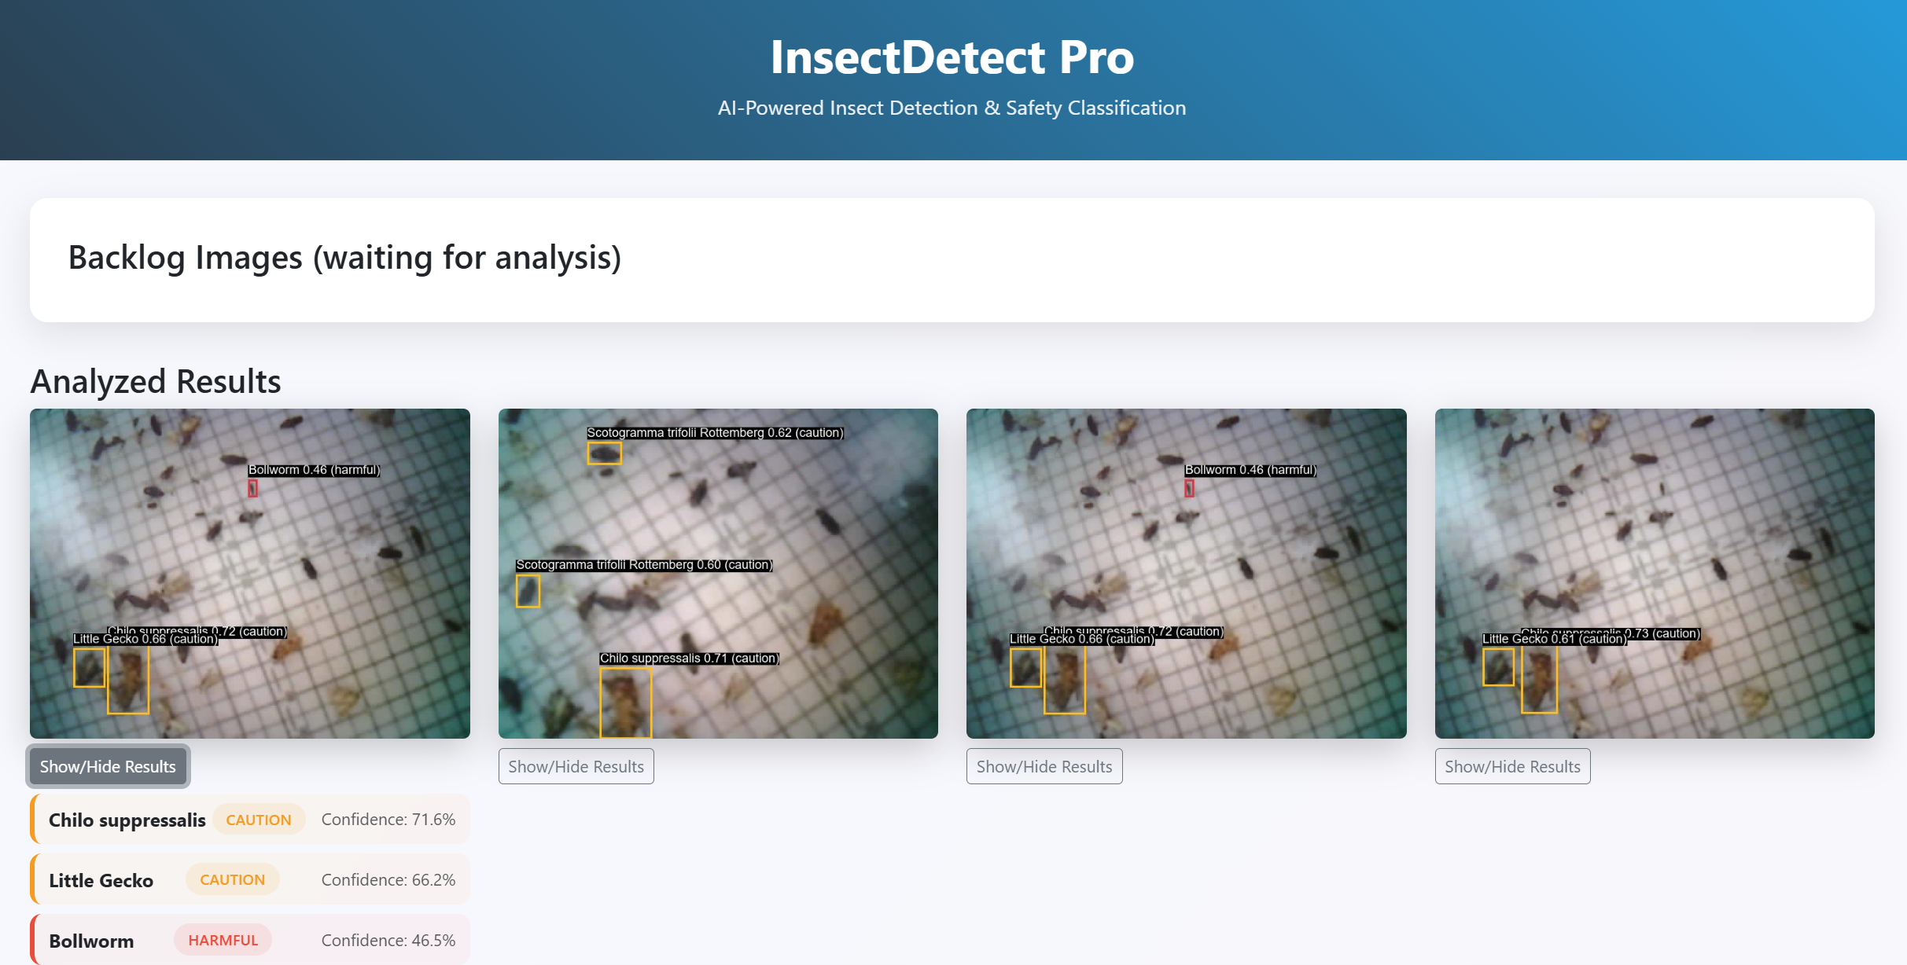
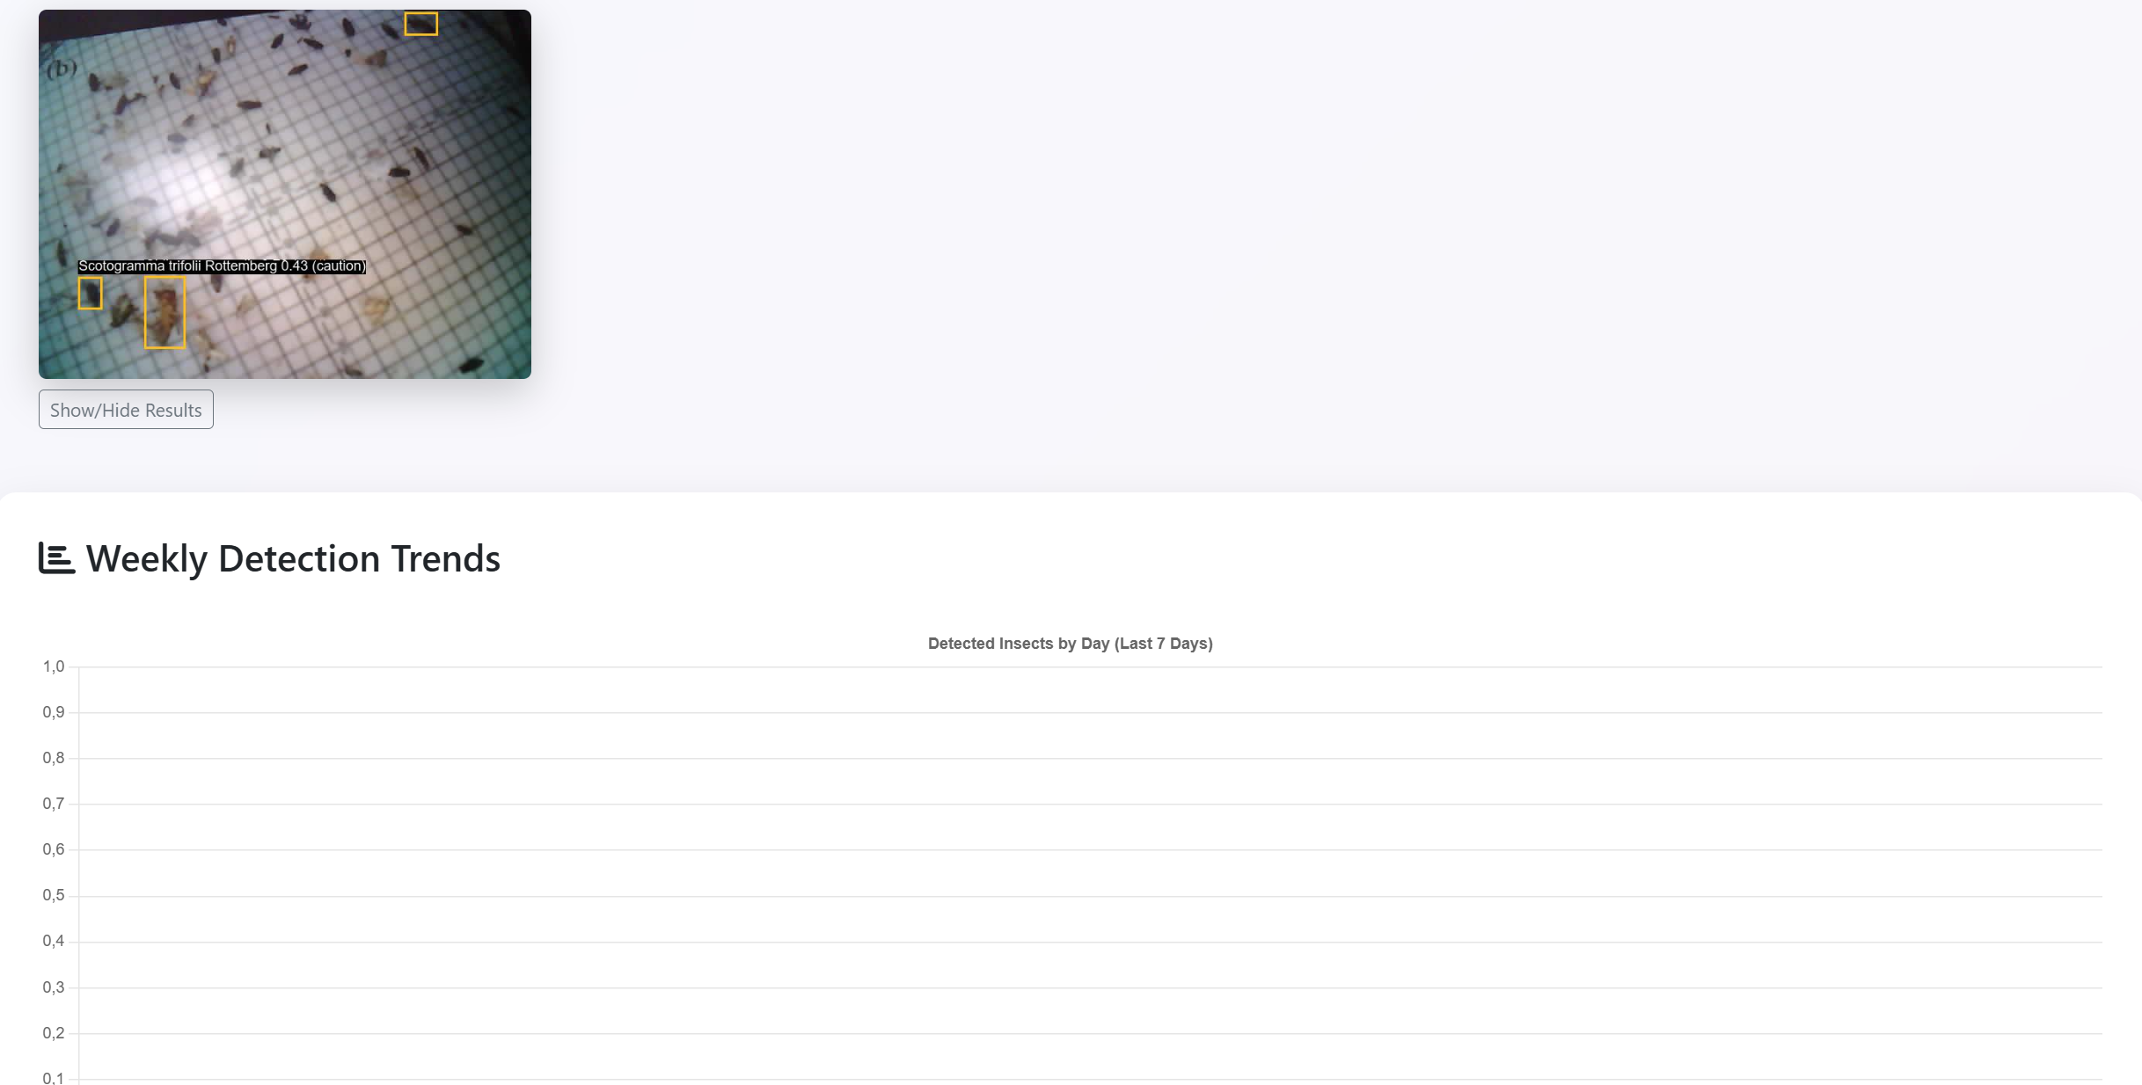
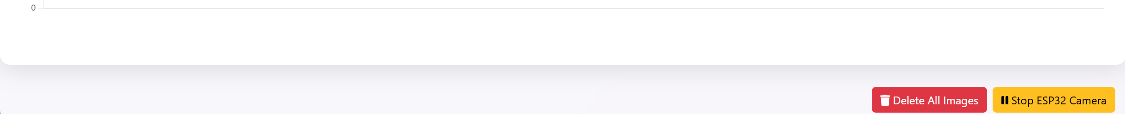
Web Dashboard Features
Real-time image analysis
Interactive analytics and trends
Remote camera control
Color-coded alerts
Mobile-responsive design
Notes:
The web dashboard serves as the primary interface between our AI system and farmers. It's designed to be intuitive and accessible, with full mobile responsiveness for field use. The main dashboard displays real-time image feeds from deployed cameras, showing both the original captured images and analysis results with color-coded bounding boxes around detected insects. Each detection includes the species name, confidence level, and risk category. The analytics section provides interactive charts showing detection trends over time, species distribution, and risk level summaries. This historical data helps farmers understand pest population dynamics and make informed decisions about treatment timing. Device management features allow farmers to remotely control their ESP32-CAM units - they can start or stop image capture, adjust capture intervals, and monitor device status and connectivity. The system implements WebSocket connections for real-time updates, meaning new detections appear on the dashboard immediately without requiring page refreshes. Automated alerts are generated based on detection categories, with different notification styles for harmful, caution, and safe species. The interface is designed to work reliably on mobile devices, recognizing that farmers often access the system while actually in the field.

Slide 8
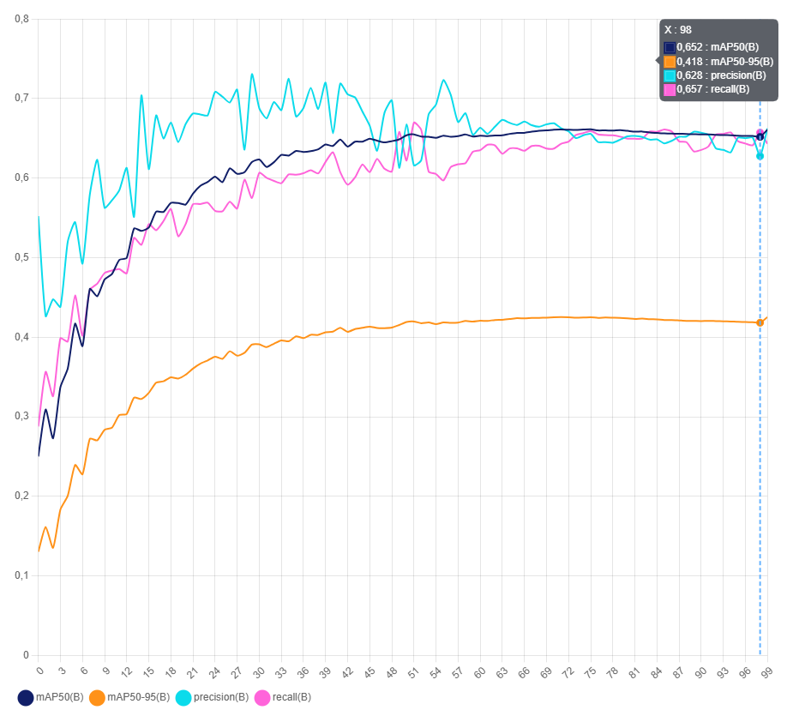
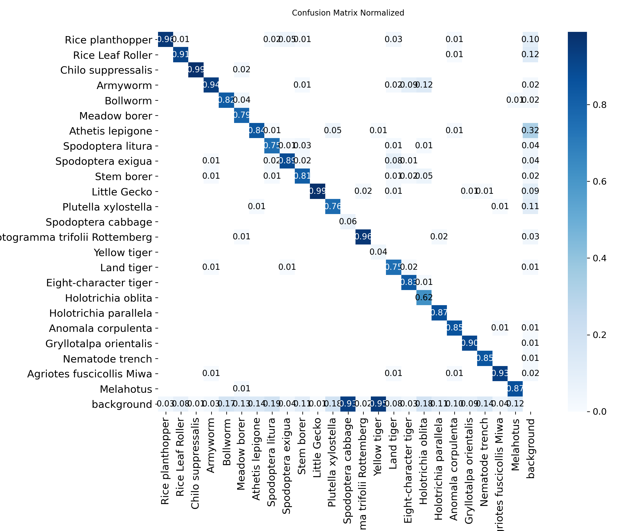
Performance Results
mAP50: 0.661, Precision: 0.663, Recall: 0.643
F1-Score: 0.653
Inference: 45ms per image
Outperforms manual detection methods
Notes:
Our system demonstrated strong performance across multiple evaluation metrics. The trained YOLOv11s model achieved a mean Average Precision at IoU 0.5 of 0.661 - that's 66.1 percent accuracy in detection tasks. The precision score of 0.663 indicates that when our system identifies an insect, it's correct about 66 percent of the time. The recall score of 0.643 means we successfully detect about 64 percent of insects present in images. The F1-score of 0.653 represents the harmonic mean of precision and recall, showing balanced performance. From a computational perspective, our system processes images with an average inference time of just 45 milliseconds per image. The compressed model size is 18.7 megabytes, making it suitable for deployment on standard server hardware. These results validate our hybrid architecture approach - by leveraging server-side processing, we achieve accuracy levels that would be impossible with on-device inference, while maintaining fast enough processing speeds for practical real-time monitoring. The system operated reliably across varying environmental conditions including different lighting situations, weather patterns, and seasonal changes.

Slide 9
System Advantages
High accuracy, low cost
Real-time detection
Scalable multi-unit deployment
Network resilience with buffering
Actionable risk-based insights
Method | Accuracy | Cost | Scalability | Real-Time
Manual Inspection | Medium | High | Low | No
Pheromone Traps | Low | Medium | Medium | No
Traditional Camera Traps | Low | High | Low | No
InsectDetect Pro | High | Low | High | Yes
Commercial IoT Solutions | High | Very High | Medium | Yes
Notes:
When compared to existing pest monitoring approaches, InsectDetect Pro offers several significant advantages. Traditional manual inspection provides medium accuracy at high labor costs with limited scalability and no real-time capability. Pheromone traps, while commonly used, offer low accuracy, medium cost, medium scalability, but again no real-time detection. Commercial IoT solutions do exist and can provide high accuracy with real-time capabilities, but they typically cost significantly more than our system and have medium scalability due to high per-unit costs. Our InsectDetect Pro system achieves high accuracy comparable to commercial solutions while maintaining low deployment costs and high scalability. The real-time detection capability gives farmers the early warning they need to make timely interventions. The key differentiator is cost-effectiveness. By using ESP32-CAM modules and open-source software components, we've created a solution that provides enterprise-level functionality at a fraction of the cost of commercial alternatives. The modular, distributed architecture means farmers can start with a single unit and expand their monitoring network as needed. The system scales linearly - adding more cameras simply means more coverage without requiring infrastructure changes. This combination of high performance, low cost, and scalability makes the system particularly suitable for smallholder farmers in developing regions who have been underserved by existing commercial solutions.

Slide 10
Challenges and Limitations
Network dependency in rural areas
Environmental impact: lighting, weather
Power management for continuous use
Seasonal variation in pests
Notes:
Like any real-world system, InsectDetect Pro faces several implementation challenges that we've worked to address. Network dependency is our primary constraint. The system requires wireless connectivity for image transmission, which can be limited in remote agricultural areas. Our buffering mechanism helps mitigate short-term connectivity issues, but extended network outages do result in delayed pest detection. Environmental factors affect detection accuracy. Varying lighting conditions throughout the day, weather effects like rain or fog, and seasonal changes in vegetation can impact the AI model's performance. Our training data may not fully represent all possible field conditions. Power management requires attention for continuous operation. While the ESP32-CAM is relatively lowpower, continuous operation in remote locations requires reliable power sources - typically solar panels with battery backup. Model accuracy, while good, isn't perfect. The 66 percent accuracy rate means some pests may be missed or misclassified. However, this still represents a significant improvement over manual inspection consistency. We've designed the system with these limitations in mind, implementing robust error handling, retry mechanisms, and graceful degradation when network or power issues occur.

Slide 11
Future Enhancements
On-device inference with model compression
Multi-spectral imaging
Weather data integration
Notes:
We have several exciting enhancement directions planned for future development. Model compression techniques like quantization and pruning could enable on-device inference, reducing network dependency and improving response times. This would allow the ESP32-CAM to perform basic detection locally, only transmitting alerts rather than full images. Multi-spectral imaging integration could improve detection accuracy under challenging lighting conditions. Near-infrared or thermal imaging capabilities would provide additional identification features beyond visible light. Weather data integration represents a significant opportunity. By incorporating local weather conditions and forecasting, we could improve prediction accuracy and enable proactive pest management recommendations based on conditions that favor pest activity. Mobile application development would improve accessibility, allowing farmers to receive push notifications and manage their systems directly from smartphones. System expansion to support multiple crop types would increase economic viability and applicability across different agricultural contexts. Integration with automated intervention systems could enable closed-loop pest management, where detection automatically triggers targeted treatment applications.

Slide 12
Economic Impact and Applications
Reduced pesticide use
Minimized crop loss
Improved sustainability
Valuable for smallholder farmers
Contribution to food security
Notes:
We have several exciting enhancement directions planned for future development. Model compression techniques like quantization and pruning could enable on-device inference, reducing network dependency and improving response times. This would allow the ESP32-CAM to perform basic detection locally, only transmitting alerts rather than full images. Multi-spectral imaging integration could improve detection accuracy under challenging lighting conditions. Near-infrared or thermal imaging capabilities would provide additional identification features beyond visible light. Weather data integration represents a significant opportunity. By incorporating local weather conditions and forecasting, we could improve prediction accuracy and enable proactive pest management recommendations based on conditions that favor pest activity. Mobile application development would improve accessibility, allowing farmers to receive push notifications and manage their systems directly from smartphones. System expansion to support multiple crop types would increase economic viability and applicability across different agricultural contexts. Integration with automated intervention systems could enable closed-loop pest management, where detection automatically triggers targeted treatment applications.

Slide 13
Conclusion
Developed practical AI pest detection system
66% detection accuracy
Cost-effective, scalable solution
Demonstrates IoT + AI viability
Foundation for next-gen agriculture
Notes:
We have several exciting enhancement directions planned for future development. Model compression techniques like quantization and pruning could enable on-device inference, reducing network dependency and improving response times. This would allow the ESP32-CAM to perform basic detection locally, only transmitting alerts rather than full images. Multi-spectral imaging integration could improve detection accuracy under challenging lighting conditions. Near-infrared or thermal imaging capabilities would provide additional identification features beyond visible light. Weather data integration represents a significant opportunity. By incorporating local weather conditions and forecasting, we could improve prediction accuracy and enable proactive pest management recommendations based on conditions that favor pest activity. Mobile application development would improve accessibility, allowing farmers to receive push notifications and manage their systems directly from smartphones. System expansion to support multiple crop types would increase economic viability and applicability across different agricultural contexts. Integration with automated intervention systems could enable closed-loop pest management, where detection automatically triggers targeted treatment applications.

Slide 14

Thank You & Questions
Notes:
Thank you for your attention. I'd like to acknowledge the invaluable guidance of my supervisor Van Lic Tran and the support of Danang University of Science and Technology and Polytech Marseille. I also want to recognize the open-source community, particularly the developers of Ultralytics YOLO, Flask, and the ESP-IDF framework, whose tools made this implementation possible. The research demonstrates that practical, impactful agricultural AI solutions can be developed using accessible technologies and open-source tools. I'm happy to answer any questions you may have about the technical implementation, performance results, deployment considerations, or potential applications of this system.

